Slide 1
15
Monopoly

Slide 2

Figure 1 Economies of Scale as a Cause of Monopoly
Cost
Average
total
cost
0
Quantity of Output
Copyright © 2004 South-Western

Slide 3
Figure 2 Demand Curves for Competitive and Monopoly Firms
(a) A Competitive Firm
’
s Demand Curve
(b) A Monopolist
’
s Demand Curve
Price
Price
Demand
Demand
0
Quantity of Output
0
Quantity of Output
Copyright © 2004 South-Western

Slide 4

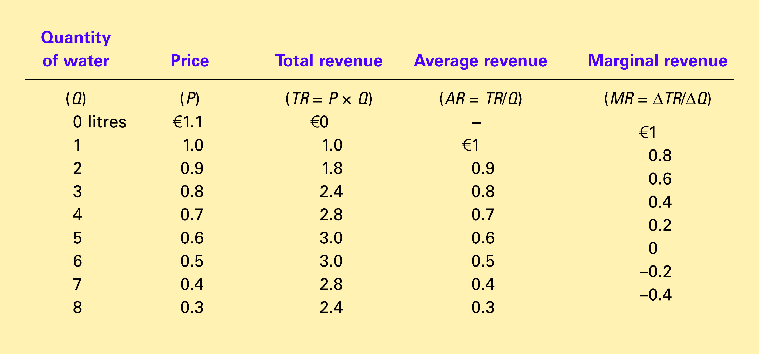
Table 1 A Monopoly’s Total, Average, and Marginal Revenue
Copyright©2004 South-Western

Slide 5
Figure 3 Demand and Marginal Revenue Curves for a Monopoly
Price
€11
10
9
8
7
6
5
4
3
Demand
2
Marginal
(average
1
revenue
revenue)
0
–1
1
2
3
4
5
6
7
8
Quantity of Water
–2
–3
–4
Copyright © 2004 South-Western

Slide 6
Figure 4 Profit Maximization for a Monopoly
Costs and
Revenue
2. . . . and then the demand
1. The intersection of the
curve shows the price
marginal-revenue curve
consistent with this quantity.
and the marginal-cost
curve determines the
B
profit-maximizing
Monopoly
quantity . . .
price
Average total cost
A
Marginal
Demand
cost
Marginal revenue
0
Q
Q_{MAX}
Q
Quantity
Copyright © 2004 South-Western

Slide 7
Figure 5 The Monopolist’s Profit
Costs and
Revenue
Marginal cost
Monopoly
E
B
price
Monopoly
Average total cost
profit
Average
total
D
C
cost
Demand
Marginal revenue
0
Q_{MAX}
Quantity
Copyright © 2004 South-Western

Slide 8
Figure 6 The Market for Drugs
Costs and
Revenue
Price
during
patent life
Price after
Marginal
patent
cost
expires
Marginal
Demand
revenue
0
Monopoly
Competitive
Quantity
quantity
quantity
Copyright © 2004 South-Western

Slide 9
Figure 7 The Efficient Level of Output
Price
Marginal cost
Value
Cost
to
to
buyers
monopolist
Demand
Cost
Value
(value to buyers)
to
to
monopolist
buyers
0
Quantity
Value to buyers
Value to buyers
is greater than
is less than
cost to seller.
cost to seller.
Efficient
quantity
Copyright © 2004 South-Western

Slide 10
Figure 8 The Inefficiency of Monopoly
Price
Deadweight
Marginal cost
loss
Monopoly
price
Marginal
revenue
Demand
0
Monopoly
Efficient
Quantity
quantity
quantity
Copyright © 2004 South-Western

Slide 11
Figure 9 Marginal Cost Pricing for a Natural Monopoly
Price
Average total
cost
Average total cost
Loss
Regulated
price
Marginal cost
Demand
0
Quantity
Copyright © 2004 South-Western

Slide 12
Figure 10 Welfare with and without Price Discrimination
(a) Monopolist with Single Price
Price
Consumer
surplus
Monopoly
Deadweight
price
loss
Profit
Marginal cost
Marginal
Demand
revenue
0
Quantity sold
Quantity
Copyright © 2004 South-Western

Slide 13
Figure 10 Welfare with and without Price Discrimination
(b) Monopolist with Perfect Price Discrimination
Price
Profit
Marginal cost
Demand
0
Quantity sold
Quantity
Copyright © 2004 South-Western

